Slide 1
Levy and Trailblazers

Slide 2
The Levy is part of a broader programme of reforms
The government is committed to significantly increasing the quantity and quality of apprenticeships in England to reach 3 million starts in 2020:
New Institute for Apprenticeships led by employers to support quality apprenticeships
Employers at the heart of designing new Apprenticeships Standards through the Trailblazer programme
Apprenticeship targets for public sector bodies – consulted on new duty on public sector to have 2.3% of its workforce comprised of apprenticeships
But a step change in the scale and quality of the apprenticeship programme also requires a step change in funding.

Slide 3
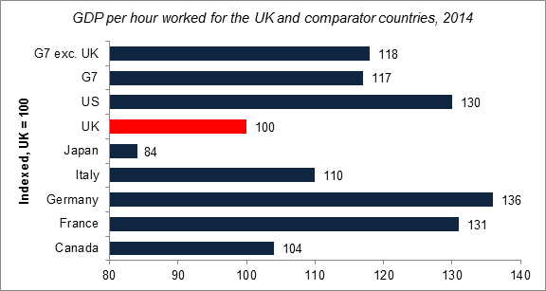
Action is needed to address current trends
UK productivity lags behind other developed economies…
Number of employees who worked fewer hours than usual because they attended a training course away from their workplace
… and employers are investing less in training
…and employers are investing less in training
Notes:
Source GDP chart= ONS, International Comparisons of Productivity, 2014.

Slide 4
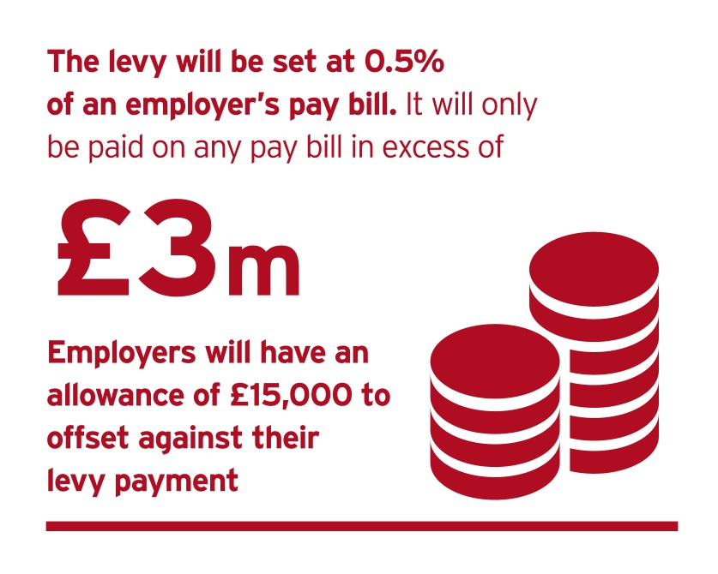
What is the levy?
The Apprenticeship Levy will be a levy on UK employers to fund new apprenticeships
The levy will be 0.5% of the pay bill, paid through PAYE
An allowance of £15,000 to offset against levy liability
The levy allowance is not a cash payment and cannot be used to purchase apprenticeship training
Any UK employer, in any sector, with
a pay bill of more than £3 million per
year is liable to pay the levy
Employers in England who pay the
levy and are committed to
apprenticeship training will be able
to get out more than they pay into
the levy, through a top-up to their
digital accounts

Slide 5
Paying the levy
LEVY PAYING EMPLOYER
NON-LEVY PAYING EMPLOYER
Employer of 250 employees, each with a gross salary of £20,000.
Pay bill: 250 x £20,000 = £5,000,000
Levy sum: 0.5% x £5,000,000 = £25,000
Allowance: £25,000 - £15,000 =
£10,000 annual levy payment
Employer of 100 employees, each with a gross salary of £20,000.
Pay bill: 100 x £20,000 = £2,000,000
Levy sum: 0.5% x £2,000,000 = £10,000
Allowance: £10,000 - £15,000 =
£0 annual levy payment
Notes:
How?
You will calculate, report and pay your levy to HMRC, through the Pay as You Earn (PAYE) process alongside income tax and National Insurance.
Single employers with multiple PAYE schemes will only have one allowance
Connected employers - we intend to allow employers to share one allowance between employers which are in connected ownership or control.
You won’t be exempt from the apprenticeship levy if you already pay into an existing levy.

Slide 6
The English apprenticeships system
Education and training is a devolved policy, which means that authorities in each of the UK nations manage their own apprenticeship programmes. For operations in England, you will be entitled to funding as described in the rest of this presentation.
The amount entering your English digital apprenticeship service account will reflect what you have available to spend through the English apprenticeship system.
Notes:
We plan to give you the same proportion of your levy payment to spend in England as the proportion of your pay bill paid to employees living in England.
For example:
If 100% of pay bill is in England 100% of levy payment in digital account
If 80% of pay bill is in England 80% of levy payment in digital account

Slide 7
Getting out more than you put in
Employers who pay the levy and are committed to apprenticeships training will be able to get out more than they pay in to the levy.
The government will apply a 10% top-up to monthly funds entering levy paying employers’ digital accounts, for apprenticeship training in England, from April 2017.
Employer has £12,000 annually entering their levy account
Monthly account funding = £1,000
Top up: 10% x £1,000 = £100
Levy monthly account increase: £1,000 + £100 = £1,100
£13,200 annually to spend on Apprenticeships
Worked example

Slide 8
How the Levy will work
10% Top up
Levy paying employer
HMRC collect levy (PAYE)
Employer views funds in digital account to spend in England
Employs Apprentice. Commits to training
Receives training for apprentice
Draw down levy funds monthly
Unused levy funds expire after 18 months
Employs Apprentice. Commits to training
Receives training for apprentice
Employer pays for proportion of cost direct to training provider
SFA pays proportion to the training provider
Non-levy paying employer
Registers with SFA
Offers apprenticeship training
Provides training to apprentice
Provides info via ILR to SFA that training has taken place & that employer has made contribution
Paid by SFA and balance by employer
Training Provider
Pass data on levy payments from HMRC to BIS
Timely data on training
Check training is complete
If funding unlocked: Pay provider
Government
Employer and Provider Identity Assurance
Notes:
Expiry of levy funds
Levy funds will expire 18 months after they enter your account unless you spend them on apprenticeship training. This will also apply to any top-ups in your account.
Levy funds which have expired will keep their value, as they will be reallocated to committed employers through the top-up to their accounts.
Directing levy funds to other employers
In the first year of the levy, you will be able to use the funds in your levy account to pay for apprenticeship training and assessment for your own employees.
We know that some employers might wish to direct their funding to other employers.
We will make an assessment of the pros and cons of any approach, including the trade-offs with other design choices, before providing further information in June

Slide 9
Co-Investment: Non-levy paying employers
CO-INVESTMENT
There are two types of employers who will be required to contribute outside the levy towards the cost of their apprenticeships training
Employers who haven’t paid into the levy
Employers who have used all funds in their digital apprenticeship account
These employers will be required to co-invest a small proportion of funding towards the cost of their apprenticeships training. We are committed to providing financial government support to these employers to pay for their apprenticeships training. We will therefore contribute a large proportion of government funding to cover the majority of the costs of apprenticeships training.
DIGITAL APPRENTICESHIP SERVICE ACCESS
If you do not pay the levy you will not need to set up a digital apprenticeship service account to pay the training provider in April 2017. You will agree a price and pay your contribution towards the costs of the training and assessment to the training provider directly. This will give you more time to prepare for the new system.

Slide 10
Funding limits
Employers will not be able to spend an unlimited amount of money on a single apprentice.
Funding bands will be set which limit the amount of levy funds an employer can spend on training for an individual apprentice.
The band will vary according to the level and type of apprenticeship (for example, more expensive, higher quality training is likely to be in a band with a higher limit).
Employers can negotiate the best price for the training they require directly with training providers.
We would encourage employers to seek the best price for the training they are purchasing. Much like all business investment decisions, employers should be empowered to get a quality service for an acceptable price.
If employers want to spend more than the funding limit themselves then they will be free to do that.
What is a funding band?
Funding bands set the ranges in which government expects the cost of training an assessment for apprenticeships to fall.
Each of the bands will set an upper limit to which government or levy funding can be used to pay for the apprentice’s training.
For example:
Laboratory Technician Apprenticeship Standard
Band 5
to £18,000

Slide 11
Funding limits– how they work
WITHIN THE FUNDING BAND LIMIT
OVER THE FUNDING BAND LIMIT
Example funding band limit = £6,000
Price you negotiate with your training provider = £5,000
The cost is within the funding band limit
Example funding band limit = £6,000
Price you negotiate with your training provider = £7,500
The cost is above the funding band limit
Levy payers
Non-levy payers*
Levy payers
Non-levy payers*
£5,000 will be deducted from your levy account over the life of the apprenticeship.
You will be required to contribute a small proportion of the £5,000 cost.
The level will be announced in June.
£6,000 will be deducted from your levy account over the life of the apprenticeship.
You will be responsible for paying £1,500. This payment can’t be made from your digital account
You will be required to contribute a small proportion of the £6,000 cost, and
You will be responsible for paying £1,500.
* Employers who have not contributed to the levy, or who have used all the funding in their accounts

Slide 12
What can you use levy or government funds for?
FUNDS CAN BE USED FOR:
apprenticeship training and assessment
(with an approved training provider and assessment organisation up to its funding band maximum)
FUNDS CANNOT BE USED FOR:
wages
statutory licences to practise
travel and subsidiary costs
managerial costs
traineeships
work placement programmes
the costs of setting up an apprenticeship programme
Apprentices who have been accepted on to an apprenticeship before April 2017 will be funded for the full duration of the apprenticeship under the conditions that were in place at the time their apprenticeship started. If you pay the levy you will not be able to use the funds in your levy account to pay for these apprenticeships.

Slide 13
Extra support
16-18 year olds
Payment to help meet the additional costs associated with employing young apprentices. This will be paid to you via the training provider.
Funding for disadvantaged individuals
You will receive the same payment (as for a 16-18 year old apprentice) if you recruit young people who are aged 19-24 who have an Education and Healthcare Plan provided by the local authority or if you employ a 19-24 year old that has been in the care of the Local Authority.
Funding for additional learning support
If your apprentice needs extra support to help meet additional learning needs we will make payments direct to the training provider to pay for these
Funding for English and Maths training
If your apprentice doesn’t already have the required minimum standard in English and Maths they may need to undertake an English and/or Maths course.
We will pay providers directly for the English and Maths courses they offer.

Slide 14
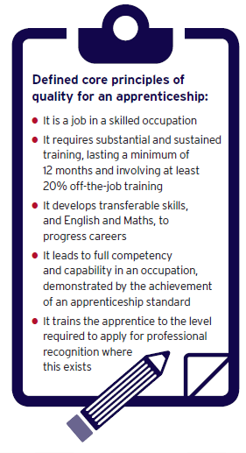
Apprenticeship Standards: what are they
Employers are designing apprenticeship standards so that they meet the needs of their industry – through the Trailblazer programme
A standard should:
be short, concise and clear
set out the full competence needed in an occupation in terms of Knowledge, Skills and Behaviour (KSBs)
have the support of employers including smaller businesses
be sufficiently stretching so that it will require at least a year of sustained and substantial training to meet the standard
align with professional registration where it exists
contain minimum English and maths requirements and
only include mandatory qualifications under certain circumstances.

Slide 15
Trailblazer progress so far
Over 150 Trailblazers currently developing over 375 standards.
Over 40% are higher/degree level
82 of these standards are now approved for delivery.
Guidance available at: https://www.gov.uk/government/publications/future-of-apprenticeships-in-england-guidance-for-trailblazers
List of standards developed / in development so far available at: https://www.gov.uk/government/publications/apprenticeship-standards-list-of-occupations-available
Employer guide to levy at: https://www.gov.uk/government/publications/apprenticeship-levy-how-it-will-work

Slide 16
Institute for Apprenticeships
An independent employer-led body that will regulate the quality of apprenticeships, set up by April 2017 (shadow form from 2016)
An independent Chair will lead a small Board comprised primarily of employers, business leaders and their representatives.
Rachel Sandby-Thomas (Shadow CEO) started in April 2016.
Outline role:
Approve/reject Expressions of Interest, standards and assessment plans
Provide advice and guidance during their development
Maintain a public database of apprenticeship standards and publish information illustrating potential gaps
Advise on the maximum rate of Government funding that should be assigned to each standard

Slide 17
Next Steps
SUMMER 2016
AUTUMN 2016
BY END 2016
APRIL 2017
High level scope
Operating detail
Transition
Operation
BIS/DfE publish provisional funding rates for different elements of the new funding regime in June
BIS/DfE publish confirmed funding rates for April 2017
SFA publish provisional funding rules
SFA publish confirmed funding rules
Full set of confirmed funding guidelines published
Digital apprenticeship service registration opens
Apprenticeship Levy operational
digital apprenticeship service operational
New funding model live
Institute for Apprenticeships in place

