Slide 1
The trade association for energy infrastructure & systems
#AcceleratingElectrification
Campaign Launch Webinar

Slide 2
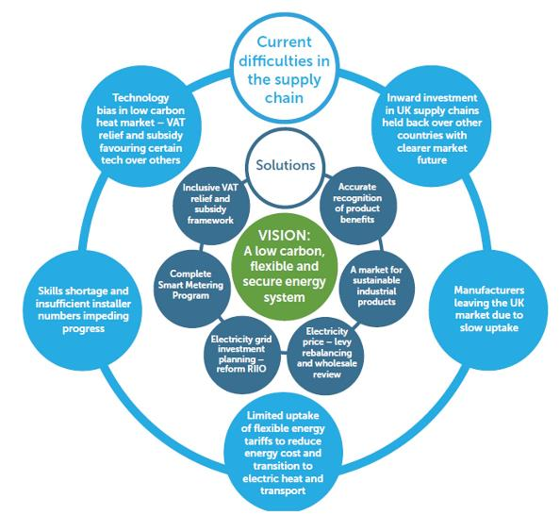
Difficulties and Solutions in the Supply Chain
The trade association for
energy infrastructure & systems

Slide 3
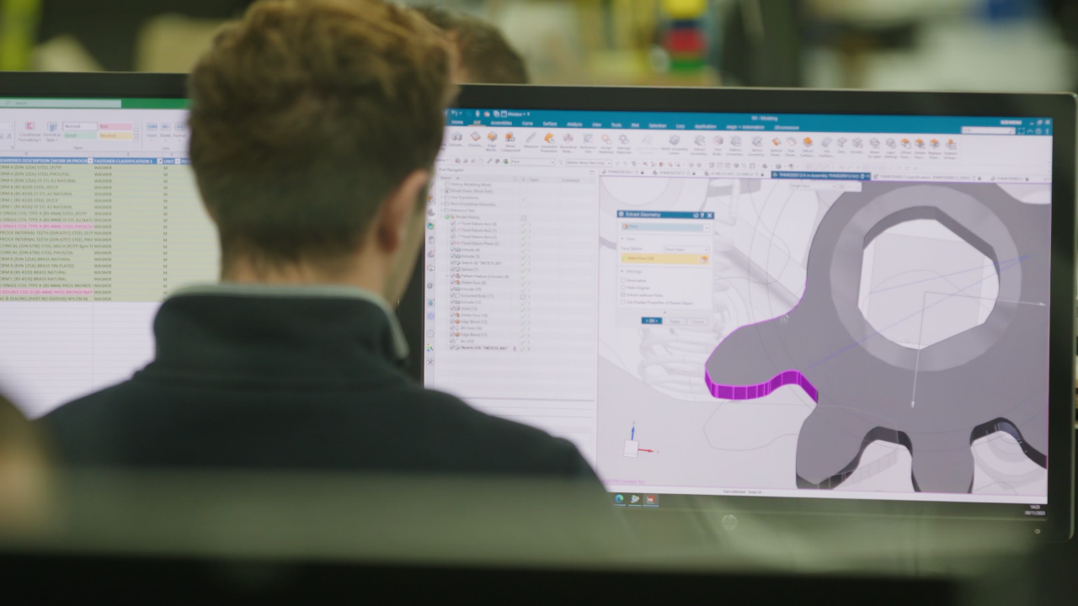
Market Pulse Report
The trade association for
energy infrastructure & systems
A quarterly review is developed and published by BEAMA
Summarises and charts businesses’ progress and intentions.
Highlights gap between projected need and actual delivery.

Slide 4
Campaign Branding
The trade association for
energy infrastructure & systems
LinkedIn Cards

Slide 5
Campaign Goals
The trade association for
energy infrastructure & systems

Slide 6
Strategy
The trade association for
energy infrastructure & systems
Through our Market Pulse report and ongoing messaging through members and aligned trade organisations, it is our objective to breath new impetus into government and Regulatory frameworks and ensure the rhetoric of electrification becomes reality.

Slide 7
Resources Available
The trade association for
energy infrastructure & systems
Members Toolkit
Campaign Pages
Market Pulse Report

