Slide 1



TARIFFS AND RULES OF ORIGIN

Slide 2
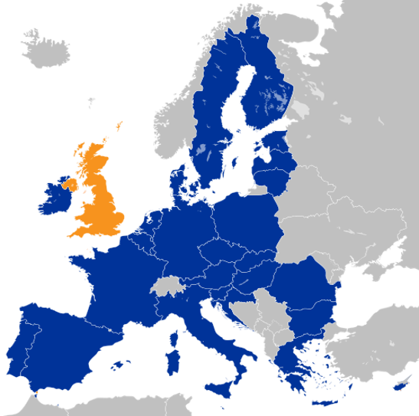

TRADING WITH THE EU FROM 1 JANUARY 2021
The UK is no longer part of the EU Customs Union. Trade is now governed by the UK-EU Trade and Cooperation Agreement (TCA) (the Northern Ireland Protocol applies to Northern Ireland).
As of 1 January 2021, UK goods exported to the EU are eligible for zero tariffs if the goods meet the Rules of Origin requirements set out in the Agreement and have the right documentation. If not, the goods may be subject to EU tariffs.
The same applies for EU goods imported into the UK.

Slide 3
WHAT ARE RULES OF ORIGIN?
Rules of Origin determine the ‘economic nationality’ of a good. They are a standard part of free trade agreements (FTAs).
Rules of Origin in the UK-EU Trade and Cooperation Agreement ensure that only goods produced in the UK or EU benefit from the zero tariff agreement.
Different goods must comply with different rules. This presentation sets out the types of rules products may need to comply with as well as the documentation required to comply.

Slide 4
DISTRIBUTION vs. PRODUCTION
The UK is no longer part of the EU Customs Union. This means that goods imported into GB cannot move freely between GB and EU Member States or vice versa. To be eligible for zero tariff export to the EU, these goods must still comply with Rules of Origin.
This means there must be a qualifying level of production in the UK. This applies to EU origin goods as well as to goods from the rest of world.
If traders move goods through GB from one EU Member State to another without the goods entering UK customs territory (i.e. without entering free circulation in GB), the goods may not need to meet Rules of Origin.

Slide 5
EXPORTING GOODS TO THE EU

Slide 6
EXPORTING: HOW DO I COMPLY WITH RULES OF ORIGIN?
If you are a UK exporter and your EU importer wants to claim zero tariffs on your goods, there are 3 key steps to work out whether your goods comply with rules of origin:
1. Classify your good
2. Understand whether your good meets the applicable rule of origin
3. Understand how to demonstrate origin to the customs authorities.
The following slides will explain what action you need to take for each of these steps.
You may choose to use a customs agent to help you with Rules of Origin. There is guidance available on GOV.UK on how to find a customs agent. You may still need to provide supporting evidence to your customs agent.

Slide 7
CLASSIFYING GOODS FOR INTERNATIONAL TRADE
For the purposes of international trade, all goods are classified under the Harmonised System, an internationally standardised system of descriptions and numbers to identify goods. You need to know the classification of your goods to find the applicable rule of origin.
The Harmonised System forms the first 6 digits of the 10-digit classification (commodity) code when importing goods into the UK or the EU.
Goods are categorised into chapters (2 digits), headings (4 digits), and subheadings (6 digits)
You can use the trade tariff look-up tool to classify your goods.
For example, tempered safety glass is classified under:
Chapter 70 – Glass and glassware
Heading 7008 – Safety glass
Subheading 700811 – Toughened (tempered) safety glass

Slide 8
STEP 2: UNDERSTAND WHETHER YOUR GOOD MEETS THE APPLICABLE RULES OF ORIGIN
You need to understand your supply chain to know where your materials or inputs come from – whether they originate in the UK or EU, or whether they come from rest of world (non-originating).
You can count EU origin materials and processing when considering whether your UK exports to the EU meet rules of origin requirements, if there is a qualifying level of production in the UK – this is called 'cumulation'.
If the good you export incorporates non-originating material, you need to comply with the relevant Product Specific Rule.
There are different rules for different goods. You will need to understand whether your goods comply with the applicable rule for that good.
You should refer to the list of Product Specific Rules in the TCA to find the applicable rule for your goods.

Slide 9
THERE ARE FOUR TYPES OF RULE A PRODUCT MAY NEED TO MEET
1. Wholly Obtained (WO)
  If a good is fully grown, born or extracted from the UK it is eligible for preferential treatment. This mainly applies to agricultural products e.g. vegetables grown in the UK, but could also apply to e.g. mineral products extracted from the soil of the UK.
2. Change in Tariff Code (CTC)
  Some rules of origin require that non-originating inputs used in production of a good must be classified in a different chapter, heading or subheading of the Harmonised System.
3. Value Added, or ’maximum non-originating material’
  If a rule requires a “maximum level of non-originating material” (MaxNOM), a certain proportion of the value of the final good must be generated in the UK, or the EU. This can include UK-originating parts, or value added in the production such as labour and manufacturing costs.
4. Specific Processing Rule (SPR)
  Some rules require a specific operation or set of operations to take place in the UK, in order for that good to be classed as UK-originating. For example, for certain chemicals, a chemical reaction must take place in the UK.

Slide 10
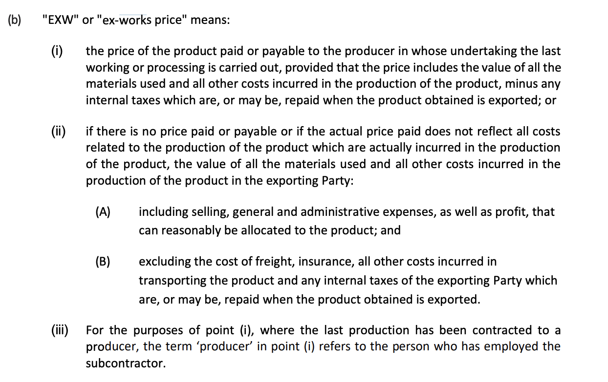
EX-WORKS PRICE

Slide 11


CUMULATION
Bilateral cumulation allows you to use both UK and EU content to meet a rule of origin
If you are importing EU products and using them in UK production to re-export to the EU, the UK production must be deemed ‘sufficient’
The list of processes that are not considered ‘sufficient’ is outlined in the text
FTA territory
Materials and processing from the UK and EU can be taken into account to meet rules of origin requirements.

Slide 12
CUMULATION & INSUFFICIENT PRODUCTION
To cumulate EU materials and export them back to the EU tariff-free, the processing in the UK must go beyond the list of processes deemed ‘insufficient’.
The following are examples of ‘insufficient production’ (the full list is available in the TCA):
preserving operations such as drying, freezing, keeping in brine and other similar operations where their sole purpose is to ensure that the products remain in good condition during transport and storage | breaking-up or assembly of packages | washing, cleaning; removal of dust, oxide, oil, paint or other coverings
affixing or printing marks, labels, logos and other like distinguishing signs on products or their packaging | simple painting and polishing operations | sharpening, simple grinding or simple cutting
sifting, screening, sorting, classifying, grading, matching including the making-up of sets of articles | simple placing in bottles, cans, flasks, bags, cases, boxes, fixing on cards or boards and all other simple packaging operations | simple assembly of parts of articles to constitute a complete article or disassembly of products into parts
“operations shall be considered simple if neither special skills nor machines, apparatus or equipment especially produced or installed are needed for carrying out those operations.”

Slide 13
STEP 3: PROVE TO THE CUSTOMS AUTHORITY THAT YOUR GOOD QUALIFIES
You must have evidence to prove your goods meet rules of origin.
You may also require evidence of origin from your supplier, such as a supplier declaration.
You can self-declare that your goods meet the Rules by making out a statement on origin and sending this to your customer with your export. Your customer can use this as the basis of their claim for zero tariffs. The template text for the statement on origin can be found in the TCA.
Importers can alternatively claim for zero tariffs based on importer’s knowledge. Where this option is used, you do not need to provide your customer with a statement on origin, though they may ask you to provide other information about the goods to support their claim for zero tariffs.
Until 31 December 2021, UK and EU exporters do not need supplier’s declarations in place when the goods are exported, but they must be confident that the exported goods meet the Rules of Origin requirements. Businesses may be asked to retrospectively provide a supplier’s declaration after this date.

Slide 14
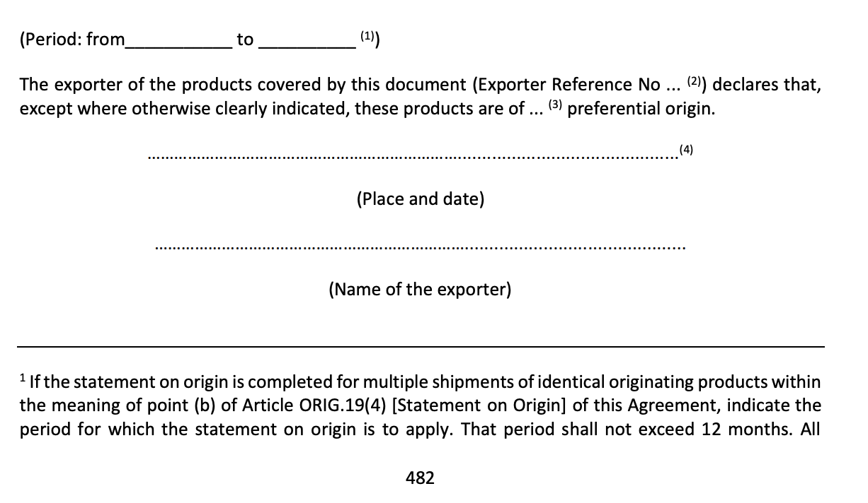
STATEMENT ON ORIGIN TEXT
A statement on origin shall be made out using one of the language versions set out in ANNEX ORIG-4 [Text of the statement on origin] in an invoice or on any other document that describes the originating product in sufficient detail to enable the identification of that product.

Slide 15
USING IMPORTER’S KNOWLEDGE
‘Importer’s knowledge’ is an option that allows the importer to claim preferential tariff treatment based on their own knowledge about the originating status of imported products. It can be used as an alternative to a statement on origin provided by the exporter.
As the importer is making a claim using their own knowledge, the exporter or producer does not need to take any action to officially state the originating status of the goods.
The exporter or producer may have to provide information about the production to the importer. Such information might include:
the HS code of the product and origin criteria used
a brief description of the production process
if applicable, a description of the originating and non-originating materials used in the production process
if the origin criterion was based on a value method, the value of the product as well as the value of all the non-originating and/or originating materials used in the production
if the origin criterion was based on a change in tariff classification, a list of all the non-originating materials including their tariff classification number under the Harmonized System (in 2, 4 or 6-digit format depending on the origin criteria); or
the information relating to the compliance with the provision on non-alteration (if applicable), for example a certificate of non-manipulation from the Customs Authority in the country of transit

Slide 16
IMPORTING GOODS FROM THE EU

Slide 17
IMPORTING: HOW TO COMPLY WITH RULES OF ORIGIN
To access zero tariffs when importing into the UK from the EU, you will need to claim preference on your customs declaration. You will need to hold proof that the goods you are importing meet the Rules of Origin.
Under the TCA, preference is claimed either with a statement on origin or using importer’s knowledge that the goods are originating. You can choose which option to use.
A statement on origin should be provided to you by the exporter on a commercial document.
To use importer’s knowledge, you will need to obtain sufficient evidence that the goods meet Rules of Origin. This may involve the exporter providing a range of supporting documentation.
The UK is taking a staged approach to customs controls. This allows traders to make a record in their own commercial records at the point of entry of goods into GB and submit a customs declaration and any claim for preference to HMRC within six months of the point of import. This easement is only for UK companies importing from the EU.

Slide 18
How to claim preferential (zero) tariffs when trading with the EU: https://www.gov.uk/guidance/claiming-preferential-rates-of-duty-between-the-uk-and-eu-from-1-january-2021
Full guidance on Rules of Origin when trading with the EU: https://www.gov.uk/government/publications/rules-of-origin-for-goods-moving-between-the-uk-and-eu-from-1-january-2021
Trade Tariff tool to classify your goods: https://www.trade-tariff.service.gov.uk/sections
Online tool to check which Rules of Origin apply to your exports: https://www.gov.uk/check-duties-customs-exporting.
Online tool to check which Rules of Origin apply to your imports: https://www.get-rules-tariffs-trade-with-uk.service.gov.uk/choose-country/
For help on importing & exporting, contact HMRC using the guidance here: https://www.gov.uk/government/organisations/hm-revenue-customs/contact/customs-international-trade-and-excise-enquiries.
Information on staged customs controls when importing into the UK:: https://www.gov.uk/government/publications/the-border-operating-model
IMPORTANT LINKS

Slide 20




Machinery/Electronics: Change in Tariff Heading (CTH)
The rule of origin for televisions is a Change in Tariff Heading. There is also an option to use the Maximum 50% Non-Originating Materials rule.
Any non-originating parts must be classified in a different HS Heading (4-digit code) to the final television.
Materials
UK Processing
Does the product qualify for tariff-free access?
The aerials are manufactured into a television in the UK. The non-originating materials used in the production of the television change heading (HS 8529 to HS 8528).
All As a result, the product meets the rules of origin, with the final productt changing from one chapter heading – HS 8525/8528 to television parts (HS 8529).
Aerials (HS 8529) are imported from Canada
Fitting work is carried out in the UK before the television is exported to the EU.
The imported non-originating materials are classified under the same heading as the final product. This does not meet the rule set out in the TCA.
Television (HS 8528) imported from Canada

Slide 21

Machinery/Electronics: Change in Tariff Heading (CTH)
The rule of origin for washing machines (8450) is a Change in Tariff Heading.
Any non-originating parts must be classified in a different HS Heading (4-digit code) to the final washing machine.
Materials
UK Processing
Does the product qualify for tariff-free access?
The parts are assembled into a washing machine in the UK. The non-originating materials used in the production of the television do not change heading (HS 845090 to HS 8450).
Washing machine parts are classified in the same heading as washing machines. The product would not qualify.
Washing machine parts (HS 845090) are imported from imported from Turkey
Washing machine (HS 8450) is imported from imported from Turkey, to be shipped to Ireland.
No processing has taken place once it has arrived into the UK for branding and packaging.
The imported non-originating materials are classified under the same heading as the final product. This does not meet the rule set out in the TCA.

Slide 22

Valves: Change in Tariff Subheading Rule (CTSH)
The product specific rule for a valve of HS heading 8481 is a Change in Tariff Subheading (6 digit HS code) or a maximum 50% non-originating material (MaxNOM 50%)
For a Change in Tariff Subheading (CTSH) rule, any non-originating (non-UK or EU originating) materials used in the production of the valve must be classified in a different subheading (6 digit code)
In addition, UK processing must still go beyond ‘insufficient production’. E.g. assembly cannot be ‘simple’. The TCA includes a list of processes that are considered ‘insufficient production’ as well as a definition of simple production.
Imported materials
UK Processing
Does the product qualify for zero tariff trade?
The non-originating Chinese actuator is classified in a different subheading to the final product so the processing meets the CTSH rule.
Because skilled labour / machinery is used, the UK processing goes beyond ‘insufficient’.
UK company imports actuator from China (HS 848190) and valve (848130) from Spain
UK company incorporates actuator and valve using skilled labour and/or machinery.
UK company exports finished valve (848130) to the EU
The non-originating Chinese actuator is classified in a different subheading to the final product so the processing meets the CTSH rule.
However, if no skilled labour/machinery is used, the processing is considered ‘insufficient’ and the product would not qualify.
UK company assembles valve using no skilled labour and/or machinery. This is classed under the TCA as ‘simple assembly’.
UK company exports finished valve (848130) to the EU
UK company imports actuator from China and valve from Spain

Slide 23

Valves: 50% Maximum Non-Originating Materials (MaxNOM)
The product specific rule for a valve of HS heading 8481 is a Change in Tariff Subheading (6 digit HS code) OR a Maximum of 50% non-originating material.
The exported product cannot be made of more than 50% (of the ex-works price) components from outside the UK and EU.
So 50% of the ex-works price of the product must be made up of UK and EU parts or manufacturing costs.
Imported materials
UK Processing
Does the product qualify for zero tariff trade?
Valve produced in the UK. UK manufacturing costs are £2000. Ex-works price of the valve is £2500.
Non-originating inputs worth less than 50% of the ex-works value of the finished valve.
The product meets the 50% maximum non-originating material rule.
Non-originating pneumatic actuator imported from China, worth £200.
Valve produced in the UK. UK manufacturing costs and UK parts are worth £1000. Ex-works price of the valve is £2500.
Non-originating inputs worth more than 50% of the ex-works value of the finished valve.
The valve does not meet the rule as non-originating (non-UK or EU) material is worth more than 50% of the ex-works price.
The valve may be able to meet the alternative rule for valves, which is a CTSH (see previous slide). If not, the product may face a tariff.
Non-originating pneumatic actuator, control valve and other parts imported from China. Parts worth £1500.

Slide 24
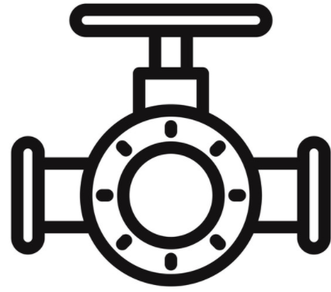
Valves: Distribution
There must be a qualifying level of production in the exporting party. Products that are distributed through the UK with no production will not qualify for zero-tariff access under the UK-EU TCA.
This applies to products from the EU as well as products from the rest of the world.
Imported materials
UK Processing
Does the product qualify for zero tariff trade?
The UK company stores the valve in a warehouse (not a bonded warehouse).
The same product, under HS heading 8481, is exported back to the EU.
There must be a qualifying level of production in the exporting party to meet rules of origin.
The product would face a tariff upon export to the EU.
UK company imports valve from EU (HS heading 8481)
The UK company stores the valve in a warehouse (not a bonded warehouse).
The same product, under HS heading 8481, is exported to the EU.
There must be a qualifying level of production in the exporting party to meet rules of origin.
The product would face a tariff upon export to the EU.
UK company imports valve from the US (HS heading 8481)
You may be able to use customs special procedures to avoid paying tariffs twice (in both the UK and EU) in this scenario: https://www.gov.uk/government/collections/pay-less-or-no-duty-on-goods-you-store-repair-process-or-temporarily-use

Slide 25

Agriculture – Prepared chicken (160232)
The rule for preparations of meat in Chapter 16 is production in which live animals, meat, and preparations of meat used are wholly obtained. Bilateral cumulation would allow the use of EU content if processing goes beyond insufficient.
Materials
UK Processing
Sufficient Processing? (PSR)
Non-originating chicken (0207) arrives in the UK.
The chicken is manufactured into a chicken nugget (160232).
All meat used in prepared meat products must be ‘wholly obtained.’ This means from animal born, raised and slaughtered in the UK or EU (if further processed).
Materials
UK Processing
Sufficient Processing? (PSR)
EU originating materials can be considered as UK originating when they are further processed beyond insufficient into new products. The processing of chicken liver to chicken pate meets the processing requirement on the EU originating materials.
EU-originating chicken liver (HS 0207) arrives in the UK.
The chicken is processed into chicken liver paté (HS 1602) in the UK.

Slide 26


Agriculture – Change in Heading
Non-originating ingredients used in the manufacture of the product must be classified in a different tariff heading (4 digit HS code)
Wholly obtained requirements for tomatoes and mushroom meaning that they need to be grown and harvested in the UK. The rule also states that non-originating sugar cannot exceed 40% of the weight of your final product. Bilateral cumulation would allow the use of EU content if processing goes beyond insufficient.
Materials
UK Processing
Sufficient Processing? (PSR)
Oranges (HS 0805) are imported from Morocco
The oranges are manufactured into marmalade in the UK. The non-originating materials used in the production of the marmalade change heading (and chapter – HS 0805 to HS 2007)
As a result, sufficient processing has taken place within the UK or EU to meet the rules of origin, with the final product meeting the specified operation (provided that the non-originating sugar used is within the specified threshold.)
Materials
UK Processing
Sufficient Processing? (PSR)
The imported non-originating materials have changed heading and chapter. However, the product rule requires the mushrooms to be ‘wholly obtained’ i.e. grown and harvested in the UK (or EU if further processed in the UK)
Mushrooms (HS 0709) are imported from China
The mushrooms are manufactured into preserved mushrooms (HS 2003) in the UK.

Slide 27


Ceramics: Change in Tariff Heading rule
The product specific rule for a mug of HS heading 6911 is a Change in Tariff Heading (4 digit HS code).
Any non-originating (non-UK or EU originating) materials used in the production of the mug must be classified in a heading other than 6911.
Materials
UK Processing
Does the product qualify for tariff-free access?
UK company manufactures a mug (HS 6911) from the imported Chinese clay (HS 2508)
The mug is exported to the EU.
The non-originating clay is classified under a different HS heading to the final mug.
This qualifies under the ‘change in tariff heading’ rule. The mug can be exported tariff-free.
UK company imports clay from China (HS heading 2508)
The imported non-originating product is classified in the same HS heading as the exported product.
This UK processing does not meet the ‘change in tariff heading’ rule. The product would face a tariff upon export to the EU.
UK company imports mug without handle from China (HS heading 6911)
The UK company attaches a wooden handle to the mug.
The mug is exported to the EU.

Slide 28
Ceramics: Distribution
There must be a qualifying level of production in the exporting party. Products that are distributed through the UK with no production will not qualify for zero-tariff access under the UK-EU TCA.
Materials
UK Processing
Does the product qualify for tariff-free access?
The UK company stores the mug in a warehouse (not a bonded warehouse).
The same product, under HS heading 6911, is exported back to the EU.
There must be a qualifying level of production in the exporting party to meet rules of origin.
UK company imports mug from EU (HS heading 6911)
The imported non-originating product is classified in the same HS heading as the exported product.
This does not meet the ‘change in tariff heading’ rule. The product would face a tariff upon export to the EU.
UK company imports mug from China (HS heading 6911)
The UK company stores the mug in a warehouse (not a bonded warehouse).
The same product, under HS heading 6911, is exported to the EU.

Slide 29

Ceramics: Re-exporting EU goods using cumulation and insufficient production
Under the UK-EU TCA, UK manufacturers can use EU materials and processing to meet a rule of origin. This is known as bilateral cumulation.
There must still be a qualifying level of production in the UK to export these goods to the EU tariff-free.
UK processing on the EU product must go beyond the list of ‘insufficient production’ processes in the TCA, e.g. ‘simple painting or polishing’
Materials
UK Processing
Does the product qualify for zero tariffs?
UK company imports blank item from Spain.
The blank is EU originating.
UK company re-fires and hand-paints the blank in the UK before exporting to the EU.
The processes undertaken in the UK go beyond ‘insufficient production’
The finished product can be exported to the EU tariff-free.
UK company imports blank item from Spain.
The blank is EU originating.
The processes undertaken in the UK fall under ‘insufficient production’.
The finished product will face a tariff upon export to the EU
UK company ‘simply’ paints the blank (requiring no special skills or machinery) before exporting to the EU

Slide 30
Ceramics: Importing RoW (Rest of World) goods & using insufficient production
Under the UK-EU TCA, UK manufacturers can use EU materials and processing to meet a rule of origin. This is known as bilateral cumulation.
There must still be a qualifying level of production in the UK to export these goods to the EU tariff-free.
UK processing on the RoW product must go beyond the list of ‘insufficient production’ processes in the TCA, e.g. ‘simple painting or polishing’
Materials
UK Processing
Does the product qualify for zero tariffs?
UK company imports blank item from China.
The blank is 3rd Country Originating.
The processes undertaken in the UK fall under ‘insufficient production’.
The finished product will face a tariff upon export to the EU
UK company ‘simply’ hand paints & re-fires the blank (requiring no special skills or machinery) before exporting to the EU

Slide 31

Ceramics: Sets
To export a set tariff-free, the TCA states that all of the products within that set must originate.
However, if the value of the non-originating (non-UK or EU originating) materials in the set make up no more than 15% of the ex-works value of the set, the whole set can be considered originating
Materials
UK Processing
Does the product qualify for tariff-free access?
UK company purchases a mug (HS 6911) and a spoon (8215)
Both the mug and the spoon originate in the UK.
UK company puts the mug and spoon together as a set.
All of the component parts are UK originating (they all meet their individual product specific rules).
The set qualifies for tariff-free access.
UK company purchases a mug (HS 6911) and a spoon (8215)
The mug originates in the UK but the spoon is Chinese.
UK company puts the mug and spoon together as a set.
The Chinese originating spoon is worth 10% of the ex-works price of the set. The rest of the set is UK originating.
Because the non-originating parts of the set are worth less than 15% of the ex-works value of the full set, the set qualifies for tariff-free access.

Slide 32

Glass and Glassware (HS Chapter 70): Change in Tariff Heading (CTH) rule
The product specific rule for most glass and glassware (products classified in HS Chapter 70) is a Change in Tariff Heading (4 digit HS code) or a Maximum 50% non-originating material. This means you can choose the option that best suits your supply chain or business model.
For example, if manufacturing a drinking glass (HS 7013), any non-originating (non-UK or EU originating) materials used in the production of the glass must be classified in a heading other than 7013.
Materials
UK Processing
Does the product qualify for tariff-free access?
UK company manufactures a rear-view mirror (HS 7009) from the imported Chinese silica sand (HS 2505)
The mirror is exported to the EU.
The non-originating silica sand is classified under a different HS heading to the final mirror.
This qualifies under the ‘change in tariff heading’ rule. The mirror can be exported tariff-free.
UK company imports silica sand from China (HS heading 2505)
The imported non-originating product is classified in the same HS heading as the exported product.
This UK processing does not meet the ‘change in tariff heading’ rule. The product would face a tariff upon export to the EU.
UK company imports drinking glass from China (HS heading 6911)
The UK company attaches a wooden handle to the mug.
The mug is exported to the EU.

Slide 33
Glass and Glassware (HS Chapter 70): Maximum 50% non-originating material (MaxNOM) rule
The product specific rule for most glass and glassware (products classified in HS Chapter 70) is a Change in Tariff Heading (4 digit HS code) or a Maximum 50% non-originating material. This means you can choose the option that best suits your supply chain or business model.
For example, if manufacturing a drinking glass, non-originating components must be less than 50% of the ex-works value of the final product. 50% of the ex-works must be made up of UK and EU parts and manufacturing costs.
Materials
UK Processing
Does the product qualify for tariff-free access?
UK company manufactures a drinking glass from the imported Turkish soda ash. UK manufacturing and parts are worth £15 and the final ex-works price is £25.
The mirror is exported to the EU.
The non-originating inputs (soda ash) are worth less than 50% of the ex-works value of the product.
This qualifies under the ‘MaxNOM 50%’ rule. The glass can be exported tariff-free.
UK company imports soda ash worth £10 from Turkey
UK company imports soda ash worth £15 from Turkey
UK company manufactures a drinking glass from the imported Turkish soda ash. UK manufacturing and parts are worth £10 and the final ex-works price is £25.
The mirror is exported to the EU.
The non-originating inputs (soda ash) are worth more than 50% of the ex-works value of the product.
This does not qualify under the ‘MaxNOM 50%’ rule. The glass may face a tariff upon import to the EU.

Slide 34
Glass and Glassware: Distribution
There must be a qualifying level of production in the exporting party. Products that are distributed through the UK with no production will not qualify for zero-tariff access under the UK-EU TCA.
Materials
UK Processing
Does the product qualify for tariff-free access?
The UK company stores the glass in a warehouse (not a bonded warehouse).
The same product, under HS heading 7013, is exported back to the EU.
UK company imports drinking glass from EU (HS 7013)
There must be a qualifying level of production in the exporting party to meet rules of origin.
The imported non-originating product is classified in the same HS heading as the exported product.
This does not meet the ‘change in tariff heading’ rule. The product would face a tariff upon export to the EU.
UK company imports drinking glass from China (HS 7013)
The UK company stores the mug in a warehouse (not a bonded warehouse).
The same product, under HS heading 7013, is exported to the EU.
You may be able to use customs special procedures to avoid paying tariffs twice (in both the UK and EU) in this scenario: https://www.gov.uk/government/collections/pay-less-or-no-duty-on-goods-you-store-repair-process-or-temporarily-use

Slide 35
Glassware: Sets
To export a set tariff-free, the TCA states that all of the products within that set must originate.
However, if the value of the non-originating (non-UK or EU originating) materials in the set make up no more than 15% of the ex-works value of the set, the whole set can be considered originating
Materials
UK Processing
Does the product qualify for tariff-free access?
UK company purchases drinking glasses (HS 7013) and spoons (8215)
Both the glass and the spoon originate in the UK.
UK company puts the glasses and spoons together as a set.
All of the component parts are UK originating (they all meet their individual product specific rules).
The set qualifies for tariff-free access.
UK company purchases drinking glasses (HS 7013) and spoons (8215)
The mug originates in the UK but the spoon is Chinese.
UK company puts the glasses and spoons together as a set.
The Chinese originating spoons are worth 10% of the ex-works price of the set. The rest of the set is UK originating.
Because the non-originating parts of the set are worth less than 15% of the ex-works value of the full set, the set qualifies for tariff-free access.

Slide 36



Yachts: Change in Chapter (CC)
The product specific rule for Yachts (HS heading 8903) is a Change in Chapter rule (CC).
This means that any non-originating parts used in the manufacture of the yacht must be classified in a different chapter (Yachts are chapter 89).
Materials
UK Processing
Sufficient Processing? (PSR)
The Korean steel and American glass are used in the production of the yacht. The non-originating materials (steel and glass) used in the production of the yacht are classified in different HS chapters to the yacht.
Because the non-originating inputs changed from chapters 72 and 70 during production, the final yacht meets the rule of origin.
Steel (HS Chapters 72 and 73) from South Korea
Glass (HS Chapter 70) from the U.S.
Materials
UK Processing
Fitting work is carried out in the UK before the yacht is exported to the EU.
The imported non-originating materials are classified under the same heading as the final product. This does not meet the rule set out in the TCA.
Yacht (HS Chapter 89) from South Korea

Slide 37
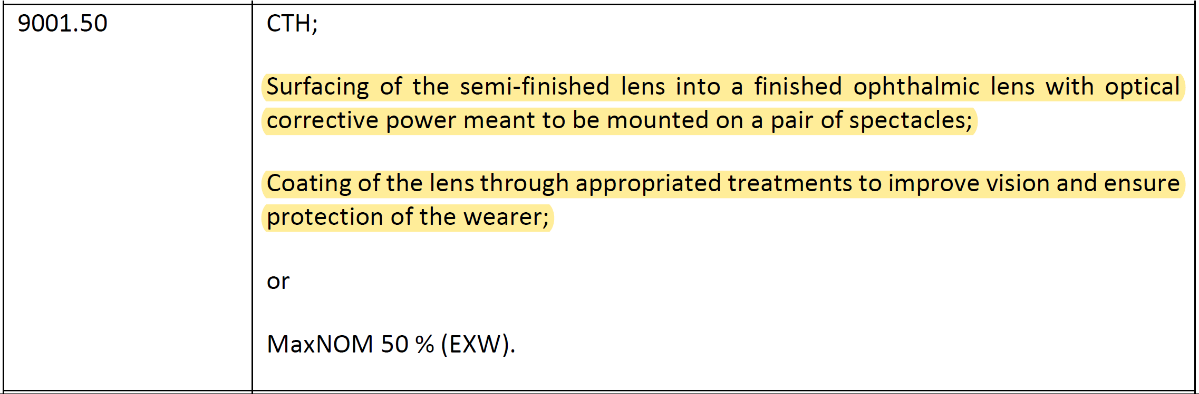

Example of Specific Processing Rule: Spectacle lenses (9001.50)
The product specific rule for spectacle lenses HS 9001.50 has a Specific Processing Rule.
This means exporters can comply with the rule by demonstrating that the product has been manufactured in the exporting country following the specific process set out in the product specific rule annex.

Slide 38

Value Added / Maximum Non-originating Material (MaxNOM) rule
The product specific rule for a ballpoint pen (HS 9608) requires maximum 50% non-originating (non UK or EU originating) materials
Materials
UK Processing
Does the product qualify?
Pen produced in the UK. UK parts, and manufacturing costs are £3.50.
Non-originating inputs worth less than 50% of the ex-works value of the transmission shaft.
Product meets the rules of origin requirements as non-originating material is less than 50% of the ex-works value.
Non-originating parts worth £3 imported from Canada
Pen produced in the UK. UK parts, and manufacturing costs are £2.50.
Non-originating inputs worth more than 50% of the ex-works value of the transmission shaft.
Product does not meet the rules of origin requirements as non-originating material is more than 50% of the ex-works value.
Product may face a tariff.
Non-originating parts worth £4 imported from Canada

