Slide 1
EU Relationship
Department for Business, Energy and Industrial Strategy
Notes:
Cover style

Slide 2
Terence Boniface
Assistant Director, Electronics and Machinery
Advanced Manufacturing Directorate
Department for Business, Energy and Industrial Strategy
Terence.Boniface@BEIS.Gov.uk
Notes:
Main slide

Slide 3
Department for Business, Energy and Industrial Strategy
BEIS
Business Sectors
Industrial Strategy
Energy Transformation
Energy and Security
EU Exit
Market Frameworks

Slide 4
Revised Political Declaration….
Comprehensive FTA “No Tariffs, fees”
“Deep Regulatory and Customs co-operation”
“Regulatory autonomy….avoid unnecessary barriers to trade in goods”
“ambitious customs arrangements”
“Common principals…standardization, technical regulation, conformity assessment…labelling”
X “will consider aligning with union rules in relevant areas”X
.
Notes:
.

Slide 5
Government Manifesto Commitments
80% of UK Trade covered by FTAs in next three years.
Commence negotiations with the USA, Australia, New Zealand and Japan.
Open up trade in services.
Tailor trade deals to the needs of British Firms and the British Economy.
.
Notes:
.

Slide 6
PM Meeting with Commission President
PM wants a broad Free Trade agreement covering goods and services…
PM clear UK would not extend the Implementation Period beyond 31 December 2020.
UK ready to start negotiations…a Canada style FTA.
President Von der Leyen
“…impossible for the UK to negotiate a comprehensive deal covering all aspects of Brexit within the timeframe set”.
Notes:
.

Slide 7
Trade Discussion Mandates
HMG to prioritize negotiations
– EU, US, Japan, Australia & NZ
RoW negotiations to proceed in Parallel with EU Negotiations.
Structures in place to understand conflicts between negotiations.
Opening High level Mandates to be completed this month – negotiations to commence February
.
Notes:
.

Slide 8
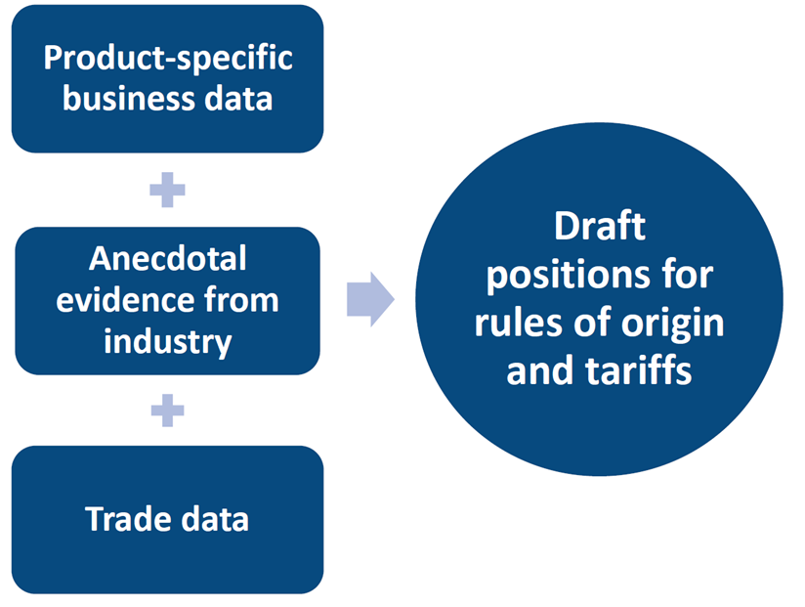
BEIS: Rules of Origin
Industry Representatives
Advised
position

Slide 9
BEIS: Conformity Assessment
Work continues to gauge the impact/costs of different types of conformity assessment requirements
On businesses..
…and the UK Conformity assessment industry.
In the EU future relationship..
…and RoW trade
Relative importance of Conformity Recognition to any trade agreement.
Understanding costs and implications of scenarios.

Slide 10
BEIS: Business Movements
UK/ EU agreed Visitors Visa Free – 90 days in 180.
CETA
Activities of Short Term Business Visitors (Annex 10D)
“After sales or after-lease service: installers, repair and maintenance personnel…warranty or other services contract incidental to the sale or lease of commercial or industrial equipment or machinery
Contractual Service Suppliers
“employees or an enterprise that has obtained a service contract for a period not exceeding 12 months…”

Slide 11
World Trade
Department for Business, Energy and Industrial Strategy

Slide 12
Trade Advisory Structures:
The Strategic Trade Advisory Group (STAG) – includes CBI and BSI
And Expert Trade Advisory Groups (ETAGs) eg:
Professional and Business Services
Automotive,
Agri-Food
Transport
Etc.
Cross cutting:
Customs ETAG – Make UK.
TAC ETAG – ADS, CBI, Make UK, SMMT.
SME ETAG
IP ETAG
BPMA – Economic and Political Update

Slide 13
UK trade covered by future FTAs

Slide 14
World Trade
Trade Agreements Continuity (TAC) Programme
Secured 16 agreements to date
72% (or £100 bn) of the continuity trade sought.
South Korea (August 2019). Total UK trade £14.6 billion.
Conformity Assessment MRAs - US, Aus, NZ and Japan.
Customs Co-operation agreed with Canada
AEO recognition expected – China, Japan (India, US)

Slide 15
Japan Trade Dialogue:
UK/Japan trade estimated to be £29.5bn 2018.
1000 Japanese businesses in the UK.
UK/Japan dialogue seeking agreement that mirrors EU-Japan Economic Partnership Agreement (EPA).
HoC voted in 2018 to support the EU signature of the EPA.
“Non-Paper” suggests Japan wish to re-explore EIF categories.
Consultation.
https://www.gov.uk/government/consultations/trade-with-japan

Slide 16
US Trade Dialogue:
UK-US trade was estimated to be £191 bn 2018.
A fifth of all UK exports. The top destination for UK FDI.
Consultation July 2018 (results published July 2019).
US trade negotiating objectives.
https://ustr.gov/sites/default/files/Summary_of_U.S.-UK_Negotiating_Objectives.pdf
Duty free market access for goods
Address non-Tariff barriers
Greater regulatory compatibility
UK objectives to be published prior to negotiations.

Slide 17
Terence Boniface
Assistant Director, Electronics and Machinery
Advanced Manufacturing Directorate
Department for Business, Energy and Industrial Strategy
Terence.Boniface@BEIS.Gov.uk
Notes:
Main slide

